Slide 1
3 TIER ARCHITECTURE
Database Management System

Slide 2
INTRODUCTION
DBMS 3-tier architecture divides the complete system into three inter-related but independent modules
In DBMS, the 3-tier architecture is a client-server architecture that separates the user interface, application processing, and data management into three distinct tiers or layers.
The 3-tier architecture is widely used in modern web applications and enterprise systems because it offers scalability, flexibility, and security

Slide 3
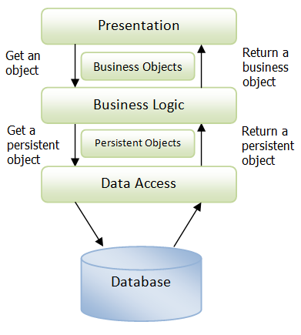
3 TIER ARCHITECTURE

Slide 4
Benefits of 3 tier architecture
Minimized redundancy and data inconsistency: Data is normalized in DBMS to minimize the redundancy which helps in keeping data consistent. For Example, student information can be kept at one place in DBMS and accessed by different users.This minimized redundancy is due to primary key and foreign keys
Simplified Data Access: A user need only name of the relation not exact location to access data, so the process is very simple.
Multiple data views: Different views of same data can be created to cater the needs of different users. For Example, faculty salary information can be hidden from student view of data but shown in admin view.
Data Security: Only authorized users are allowed to access the data in DBMS. Also, data can be encrypted by DBMS which makes it secure.
Concurrent access to data: Data can be accessed concurrently by different users at same time in DBMS.
Backup and Recovery mechanism: DBMS backup and recovery mechanism helps to avoid data loss and data inconsistency in case of catastrophic failures.

Slide 5
Presentation layer
This layer represents the user interface of the application. It is responsible for displaying information to the user and capturing user inputs.
Responsibilities:
Handles user interactions.
Presents data in a user-friendly format.
Collects user inputs and forwards them to the application server.
Provides a platform for user authentication and authorization.

Slide 6
Business logic layer
This is where the application's logic and functionality reside. It processes the user's requests, interacts with the database, and handles business rules.
Responsibilities:
Receives user requests from the presentation layer.
Implements business logic and rules.
Interacts with the database for data retrieval, manipulation, and storage.
Generates dynamic content to be sent back to the presentation layer.

Slide 7
Database layer
This layer is responsible for managing the actual database. It handles tasks such as storing, retrieving, updating, and deleting data.
Responsibilities:
Manages the physical storage of data.
Provides mechanisms for querying and modifying data.
Enforces data integrity and security through mechanisms like transactions and access controls.
Optimizes database performance for efficient data retrieval.

Slide 8
conclusion
In summary, the 3-tier architecture separates the concerns of user interface, application logic, and database management.
This design pattern promotes scalability, maintainability, and reusability of components.
Each layer can be developed and maintained independently, allowing for easier updates and enhancements to the system.

